Slide 1

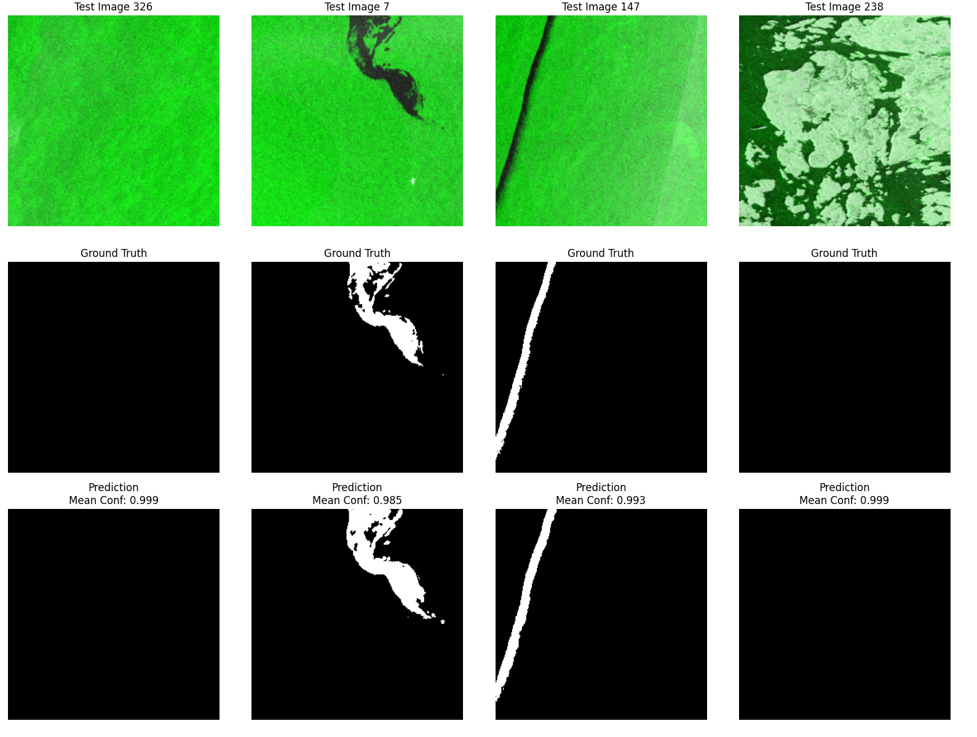

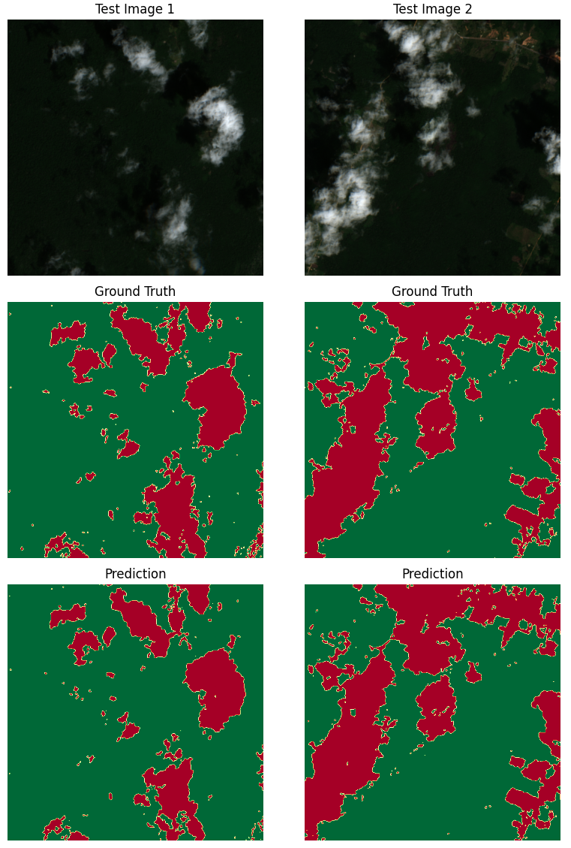


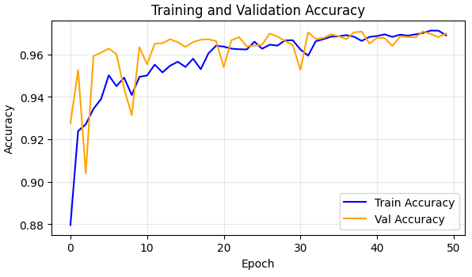
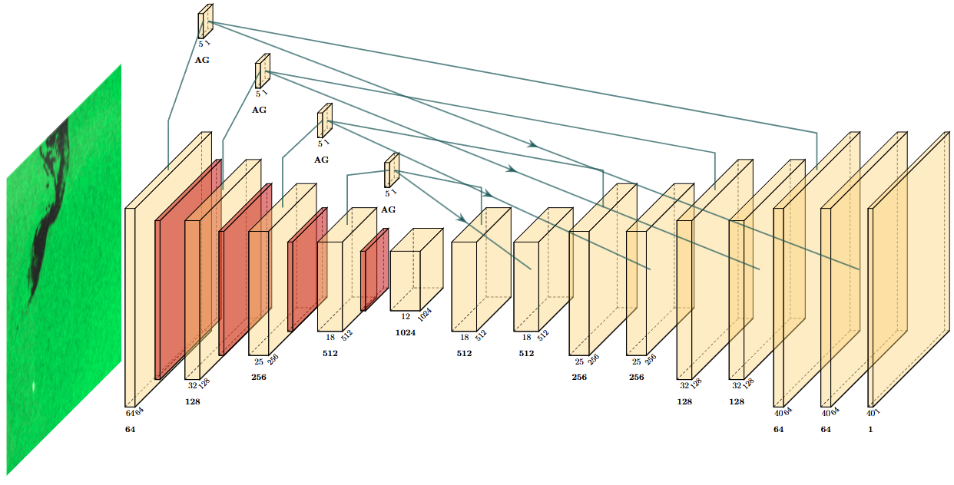



Mind The Slick: Adaptation of Attention U-Net for Satellite-Based Ocean Oil Spill Detection
Nicholas Tobias
MSc Artificial Intelligence for Sustainable Development, UCL Computer Science
GitHub: https://github.com/nicholas-tobias-00/attention_unet_for_oil_spill
Original Paper
Datasets, Adaptation, and Model Architecture
Model Performance and Evaluation
This project builds on top of John D. and Zhang C. (2022) paper on deforestation segmentation [1]. The paper outlines several key concepts:
Introduces the Attention U-Net architecture that in theory improves focus on relevant spatial features (forest / non-forest) for segmentation.
Pursues environmental monitoring by detecting deforestation.
Establishes the baseline result between multiple convolution models, with Attention U-Net having the best scores.
This project utilizes the same principle of John D. and Zhang C. (2022)’s deforestation paper with two significant modifications:
I. Dataset modifications
The original dataset used for deforestation mapping is replaced with Sentinel-1 GRD ocean imagery, requiring adjustments in preprocessing steps
The project uses a labeled oil spill dataset from previous work by Trujillo-Acatitla et al. (2024) [2]. In detail, the following data has been provided:
  3,020 labelled oil spill data with
  Out of 3,020 labelled data:
    1,350 oil images
    1,520 not oil images, with 835 being a lookalike
Additional data can be processed by downloading high resolution Sentinel-1 GRD images in dual polarization (IW mode, VV, VH) images from ASF DAAC / Copernicus Open Access Hub and then performing the following processing with SNAP (SeNtinel Applications Platform):
II. Model Modifications
Dataset balancing through training with weighted binary cross entropy loss function has been applied. This counters the small proportion of oil spills compared to the background.
  This ensures the overall training process to focus more on detected oil spills and preventing a lazy network from predicting “all ocean”.
  Ablation study has been conducted in which weighted BCE shows significant improvement over unweighted.
The proposed Attention U-Net architecture is implemented with the following results:
Metrics | BCE | Weighted BCE
Accuracy: | 97.9% | 98.3%
Precision: | 87.6% | 74.1%
Recall: | 29.1% | 58.8%
F1-Score: | 43.7% | 65.6%
IoU: | 28.0% | 48.8%
Key Observations (after 20 epochs):
Weighted BCE helps address imbalanced dataset, increasing recall and IoU significantly
Model achieved high accuracy, but scores lower on other metrics.
  Accuracy is high as “no oil” cases are abundant.
  Model can detect oil spills correctly but still requires improvement in its segmentation quality.
Relevant SDGs
Reproduced Metrics and Sample Prediction
Primary (15.1, 15.2, 15.5)
monitoring land-cover change and tracking deforestation.
Baseline vs Reproduced | Accuracy | Precision | Recall | F1
Baseline | 97.5% | 97.6% | 97.5% | 97.5%
Reproduced | 97% | 98.1% | 95.9% | 97%
Primary (13.1 and 13.2)
provides data for land-use and detect environmental changes early.
Apply Orbit File
Thermal Noise Removal
Radiometric
Calibration
Speckle Filtering
Terrain Correction
Dual Polarization Sigma0 dB
Primary (12.2 and 12.6)
transparent land use monitoring and accountability for industries linked to deforestation
Figure 2 : Sentinel-1 GRD Image Processing Pipeline with SNAP
Secondary (9.5)
Supporting research and innovation in remote sensing and AI.
Figure 4: Oil Spill Detection Test Metrics and Sample Predictions
Figure 1 (Clockwise Order): Training Curve and Relevant SDGs, Metrics Comparison, and Sample Predictions for Reproduced Model (epoch = 50)
Reflection on Sustainable Development Goals
New Context
This project shows the use of AI and satellite imagery to support environmental protection. Using Attention U-Net for oil spill detection aligns the work with key SDGs, demonstrating how digital innovation improves monitoring and strengthens climate resilience.
Stemming from the success of the deforestation detection with Attention U-Net, we push our focus to oil spill segmentation, a task equally critical given that:
Ocean life is critical to humanity, based on UN’s Food and Agriculture Organization report:
  Supports the livelihood of more than 3 billion people
  Produces 50% of earth’s O2
  Absorbs 30% of earth’s CO2
Oil spills severely damage the ecosystem by killing marine life directly, as well as poison their habitats for years, potentially leading to a change in the food chain.
The monitoring of oceans is very difficult given that it encompasses two-thirds of the earth’s surface. With most ocean territory being international waters, it is also extremely hard to enforce laws over oil spills.
These challenges point to the need for automated ocean monitoring, and Attention U-Net provides a strong solution by being able to focus on subtle patterns while suppressing the many irrelevant background noise of the ocean.
Primary SDG – 14: Life Below Water (14.1, 14.2, 14.A)
14.1: Reducing marine pollution by early oil spill detection.
14.2: Supports protection of marine ecosystem by monitoring.
14.A: Contributes to enhancing ocean science.
Figure 3 : Attention U-Net Diagram (made with PlotNeuralNet [3])
Primary SDG – 13: Climate Action (13.1, 13.2, 13.3)
13.1: Increasing resilience and adaptive capacity to climate-related hazards.
13.2: Provides data to support further climate action or policies.
13.3: Provides foundation for autonomous monitoring and awareness of oil spills.
Training Information
Dataset split for train / validation / test split : 2,184 / 386 / 450 (72% / 13% / 15%)
Total dataset size : 127 GB
Final training has been conducted with an RTX 5070:
  Total runtime : 4.5 hours
  Epoch : 20
  Learning Rate : 1e-4
Primary SDG – 12: Responsible Consumption and Production (12.4, 12.6)
12.4: Supports safe management of toxics and chemicals by autonomous monitoring and early detection.
12.6: Encourages companies to adopt sustainable practice by raising accountability.
Possible Negative SDG Interactions:
SDG 7.2: Increased energy usage for model training
SDG 8.5: Automation of monitoring tasks may reduce certain job roles.
SDG 9.1: Heavy reliance on advanced compute and satellite systems may widen technological inequalities.
References:
[1]. John, D. & Zhang, C. (2022) ‘An attention-based U-Net for detecting deforestation within satellite sensor imagery’, International Journal of Applied Earth Observations and Geoinformation, 107, p. 102685.
[2]. Trujillo-Acatitla, R., Tuxpan-Vargas, J., Ovando-Vázquez, C. & Monterrubio-Martínez, E. (2024) ‘Marine oil spill detection and segmentation in SAR data with two steps Deep Learning framework’, Marine Pollution Bulletin, 204, p. 116549.
[3]. HarisIqbal88. (n.d.). PlotNeuralNet [Computer software]. GitHub. https://github.com/HarisIqbal88/PlotNeuralNet/tree/master
Notes:
The original dataset used for deforestation mapping is replaced with Sentinel-1 GRD ocean imagery, requiring adjustments in preprocessing steps.
SAR-specific operations such as radiometric calibration, speckle filtering, and terrain correction are applied to prepare the data.
Labels are adapted to represent oil spill regions, requiring binarisation and reformatting to match the input pipeline.
Image patching, resizing, and normalisation are revised to suit the characteristics of marine spill patterns

Slide 2














Slide 3

This project utilizes the same principle of John D. and Zhang C. (2022)’s deforestation paper with two significant modifications:
…
…
Relevant SDGs
Secondary SDGs
SDG 6.3: Helps improve water quality by identifying pollution events that threaten coastal ecosystems.
SDG 6.6: Supports the protection of ocean environments by early monitoring of spills.
SDG 9.1 / 9.4: Demonstrates the application of digital infrastructure and AI in enhancing environmental monitoring systems.
SDG 9.5: Strengthens scientific research and innovation in the field of remote sensing and sustainable technology.
Relevant SDGs
Reflection on SDG
Supports 14.1: Reducing marine pollution by enabling early oil-spill detection from satellite imagery.
Contributes to 14.2: Protecting and restoring marine ecosystems through continuous remote monitoring.
Advances 14.A: Improving marine scientific knowledge using AI-driven analysis of ocean conditions.
Strengthens 13.1: Increasing resilience and adaptive capacity to climate-related hazards.
Supports 13.2: Integrating climate change measures into policies through data-driven environmental monitoring.
Advances 13.3: Improving awareness and institutional capacity via accessible AI tools for environmental agencies.
Contributes to 12.2: Sustainable management and efficient use of natural resources (forests, oceans).
Supports 12.4: Environmentally sound management of chemicals and pollution (oil spills).
Advances 12.6: Encourages companies to adopt sustainable practices through transparent monitoring.
…
…
…
…
…
…

